Slide 1
CH-4 project time management

Slide 2
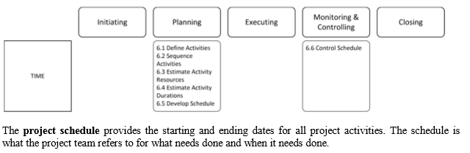
Importance of Project Schedules
Managers often cite delivering projects on time as one of their biggest challenges
Schedule issues are the main reason for conflicts on projects, especially during the second half of projects

Slide 3
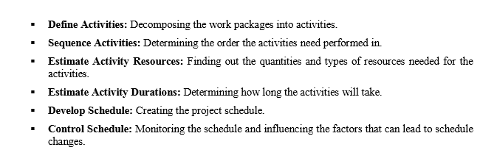

Slide 4
Work Breakdown Structure (WBS)
A detailed, hierarchical (from general to specific) tree structure of deliverables and tasks that need to be performed to complete a project.
Purpose: to identify actual tasks to be done in a project. Serves as basis for project planning.

Slide 5
Work Breakdown Structure
Identify the major task categories
Identify sub-tasks, and sub-sub-tasks
Use verb-noun to imply action to something
Example: Getting up in the morning
Hit snooze button
Hit snooze button again
Get outa bed
Avoid dog
Go to bathroom…

Slide 6
Create WBS
Decomposition of project deliverables and activities into smaller, more manageable parts
The lowest level in WBS is a Work Package based on Statement Of Work (SOW)
Needs to be S.M.A.R.T (Specific, Measurable, Attainable, Realistic, Timely)

Slide 7
Work Breakdown Structure
Canoe Trip to
Boundary Waters
Arrange Travel
Schedule Flights to Mpls
Rent Van
Arrange Motel
Schedule return flights
Get Equipment
Contact BW Outfitter
Rent canoes
Rent Tents
Bring
Sleeping Bags
Bring
Fishing Gear
Bring lights and
waterproof
matches
Plan Meals
Bring cooking gear
Freeze dry food
Prepare 7
breakfasts
Prepare 7 lunches
Prepare 6 dinners
Prepare Budget
Assign Budget Person
Get deposits
Retain Receipts
Pay for supplies
Close-out trip
Plan for
Emergencies
Obtain
emerg. #’s
Arrange
contact at BW
Bring
emerg. flares
Bring two
first aid kits
Plan Activities
Bring Cards
Bring
Joke book
Bring scotch

Slide 8
Work Breakdown Structure
Canoe Trip to
Boundary Waters
Arrange Travel
Schedule Flights to Mpls
Rent Van
Arrange Motel
Schedule return flights
Get Equipment
Contact BW Outfitter
Rent canoes
Rent Tents
Bring
Sleeping Bags
Bring
Fishing Gear
Bring lights and
waterproof
matches
Plan Meals
Bring cooking gear
Freeze dry food
Prepare 7
breakfasts
Prepare 7 lunches
Prepare 6 dinners
Prepare Budget
Assign Budget Person
Get deposits
Retain Receipts
Pay for supplies
Close-out trip
Plan for
Emergencies
Obtain
emerg. #’s
Arrange
contact at BW
Bring
emerg. flares
Bring two
first aid kits
Plan Activities
Bring Cards
Bring
Joke book
Bring scotch

Slide 9
Work Breakdown Structure
Canoe Trip to
Boundary Waters
Arrange Travel
Schedule Flights to Mpls
Rent Van
Arrange Motel
Schedule return flights
Get Equipment
Contact BW Outfitter
Rent canoes
Rent Tents
Bring
Sleeping Bags
Bring
Fishing Gear
Bring lights and
waterproof
matches
Plan Meals
Bring cooking gear
Freeze dry food
Prepare 7
breakfasts
Prepare 7 lunches
Prepare 6 dinners
Prepare Budget
Assign Budget Person
Get deposits
Retain Receipts
Pay for supplies
Close-out trip
Plan for
Emergencies
Obtain
emerg. #’s
Arrange
contact at BW
Bring
emerg. flares
Bring two
first aid kits
Plan Activities
Bring Cards
Bring
Joke book
Bring scotch

Slide 10
Work Breakdown Structure
Canoe Trip to
Boundary Waters
Arrange Travel
Schedule Flights to Mpls
Rent Van
Arrange Motel
Schedule return flights
Get Equipment
Contact BW Outfitter
Rent canoes
Rent Tents
Bring
Sleeping Bags
Bring
Fishing Gear
Bring lights and
waterproof
matches
Plan Meals
Bring cooking gear
Freeze dry food
Prepare 7
breakfasts
Prepare 7 lunches
Prepare 6 dinners
Prepare Budget
Assign Budget Person
Get deposits
Retain Receipts
Pay for supplies
Close-out trip
Plan for
Emergencies
Obtain
emerg. #’s
Arrange
contact at BW
Bring
emerg. flares
Bring two
first aid kits
Plan Activities
Bring Cards
Bring
Joke book
Bring scotch

Slide 11
Work Breakdown Structure
System Hardware Replacement
RFP Development
Needs Assessment
Needs Analysis
Write RFP
Finalize with Purchasing
Vendor Selection
Research Vendors
Research Sites
Select Vendors to mail RFP
Review Proposals
Rank Proposals
Recommendation
Staff Training
Identify training Plan
Schedule Training
Train
Hardware Implementation
Schedule Installation
Prepare Site
Arrange Vendor Support
Configure System
Install System

Slide 12
Work Breakdown Structure
System Hardware Replacement
RFP Development
Assess Needs
Analyze Needs
Write RFP
Finalize with Purchasing
Vendor Selection
Research Vendors
Research Sites
Select Vendors to mail RFP
Review Proposals
Rank Proposals
Make Recommendations
Staff Training
Identify training Plan
Schedule Training
Train Sysadmins
Hardware Implementation
Schedule Installation
Prepare Site
Arrange Vendor Support
Configure System
Install System

Slide 13
Work Breakdown Structure
Requires structured brainstorming

Slide 14
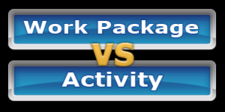
Defining activity
An activity or task is an element of work normally found on the work breakdown structure (WBS) that has an expected duration, a cost, and resource requirements
Input
1) Scope Baseline 2) Enterprise Environment Factors 3) Organizational Process Assets
Tools/Techniques
1) Decomposition 2) Component Planning 3) Templates 4) Expert Judgment
Output
1) Activity List 2) Activity Attributes 3) Milestone List

Slide 15
An activity list is a tabulation of activities to be included on a project schedule that includes
Activity attributes
Activity attributes are details of project activities which are used to help project planning and scheduling. These details are necessary because they allow the project team not only to understand the work requirements associated with each project activity, but also to consider how activities may impact one another and affect the overall project.
activity codes, the specific people involved in the activity, locations for the activity, the time and costs required for completion, etc.
A milestone is a significant event that normally has deadlines;
Examples include obtaining customer sign-off on key documents or completion of specific products

Slide 16
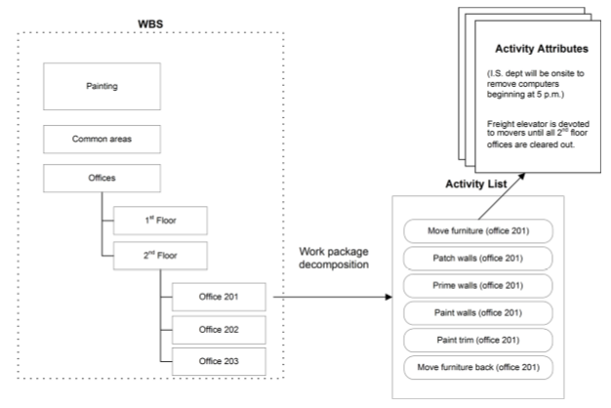

Slide 17
Sequencing Activities
Involves reviewing activities and determining dependencies
A dependency or relationship is the sequencing of project activities or tasks
You must determine dependencies in order to use critical path analysis
Input
1) Activity List & Attributes 2) Milestone List 3) Scope Statement 4) Org Process Assets
Tools/Techniques
1) Determine Dependency 2) PDM 3) Apply Leads/Lags 4) Schedule Network templates
Output
1) Project Schedule Network Diagrams 2) Update Project Docs

Slide 18
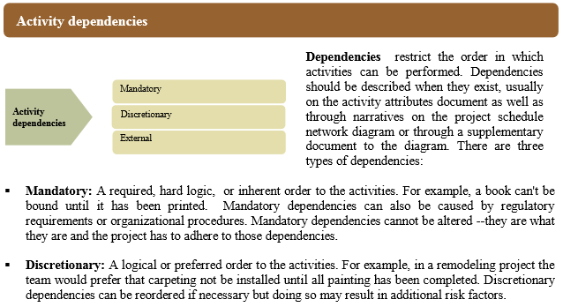

Slide 19
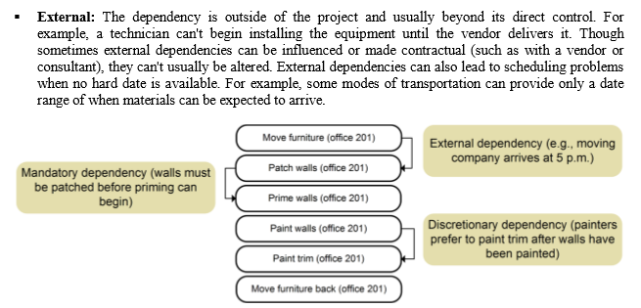

Slide 20
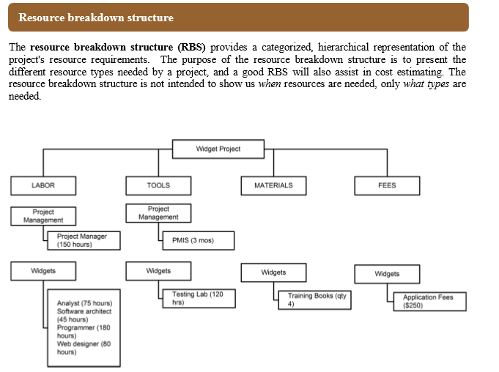
Estimating Activity Resources

Slide 21
Consider important issues in estimating resources
How difficult will it be to do specific activities on this project?
What is the organization’s history in doing similar activities?
Are the required resources available?

Slide 22
Activity Duration Estimating
Duration vs. Effort
People doing the work should help create estimates, and an expert should review them
Instead of providing activity estimates as a discrete number, such as four weeks, it’s often helpful to create a three-point estimate

Slide 23

Stable Activities
straightforward estimating
Dependent Activities
amount needed for testing is dependent on a successful test or unsuccessful test.
3-point estimates or analogous work well.
Uncertain Activities
No previous precedence (complex projects)
Start with 3-point estimate to set boundaries then use analogous to set actual estimate

Slide 24
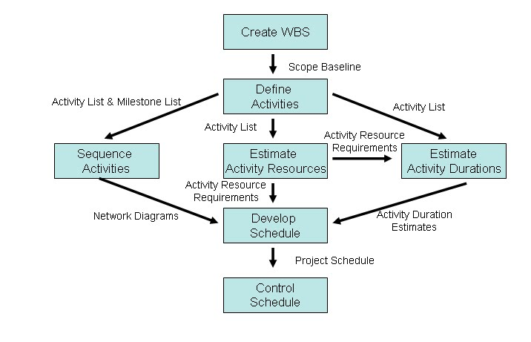
Developing the Schedule
Ultimate goal is to create a realistic project schedule that provides a basis for monitoring project progress for the time dimension of the project

Slide 25
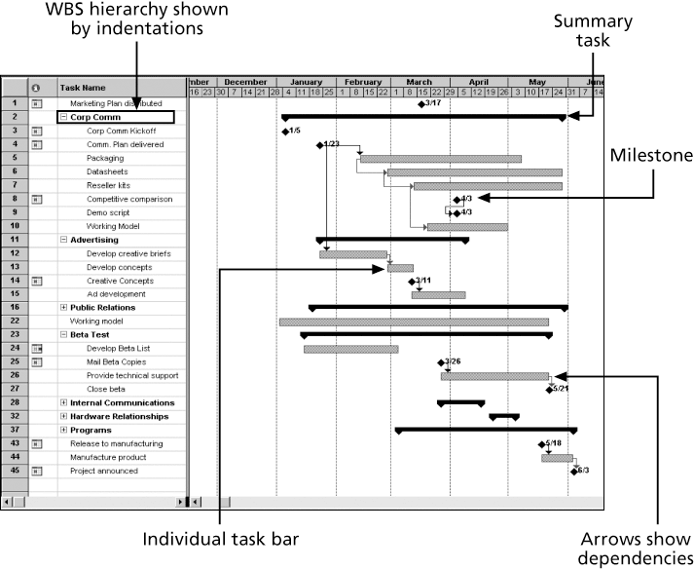
Gantt charts provide a standard format for displaying project schedule information by listing project activities and their corresponding start and finish dates in a calendar format

Slide 26
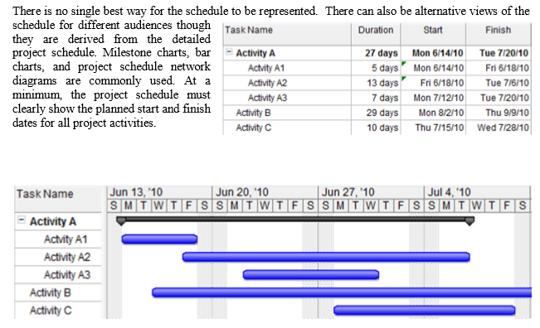

Slide 27
Project Time Management Techniques
Critical Path Method:
CPM is a network diagramming technique used to predict total project duration
A critical path for a project is the series of activities that determines the earliest time by which the project can be completed

Slide 28
Cpm & pert
CPM (Critical Path Method) is used to assist the project manager in scheduling the activities (i.e., when should each activity start). It assumes that activity durations are known with certainty.
PERT (Program Evaluation and Review Technique) is used to assist in project scheduling similar to CPM. However, PERT assumes that activity durations are random variables (i.e., probabilistic)
A network diagram is a schematic display of the logical relationships among, or sequencing of, project activities
Two main formats are the arrow and precedence diagramming methods

Slide 29
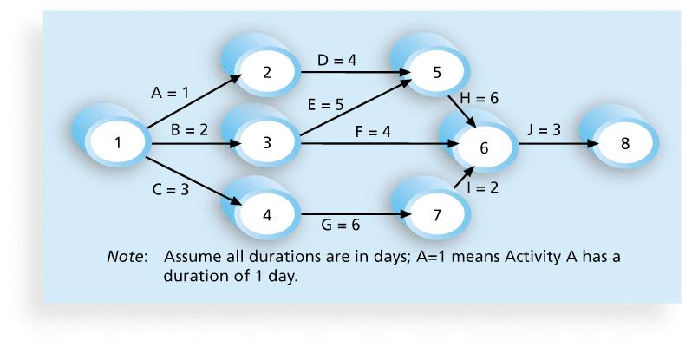
Activity-on-arrow (AOA) or Arrow Diagramming Method (ADM)
Activities are represented by arrows
Nodes or circles are the starting and ending points of activities
Can only show finish-to-start dependencies

Slide 30
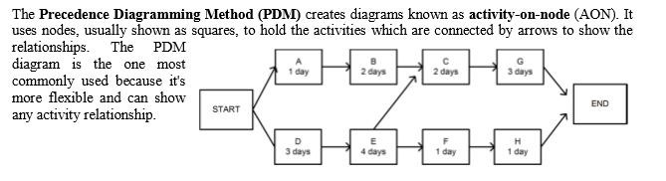

Slide 31
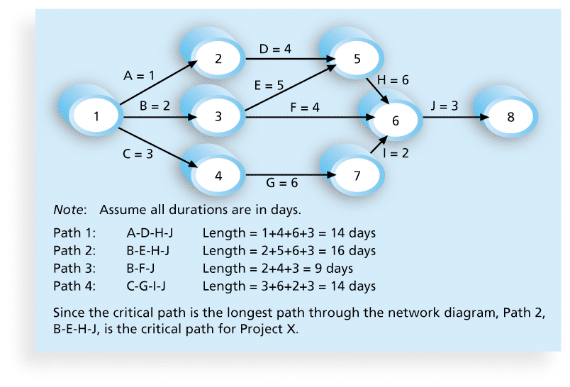

Slide 32
Techniques for shortening schedules
Crashing Activities
Fast tracking Activities
Updating Critical Path
Continually update project schedule information to meet time goals for a project
Critical path can change as you enter actual start and finish dates
If you know the project completion date will slip, negotiate with the project sponsor

Slide 33
Program Evaluation and Review Technique (PERT)
PERT is a network analysis technique used to estimate project duration when there is a high degree of uncertainty about the individual activity duration estimates
PERT weighted average = optimistic time + 4X most likely time + pessimistic time
6
Example: What days should be included for the following activity:
Activity A:
Optimistic Estimate = 8 days
Most Likely Estimate = 10 days
Pessimistic Estimate = 24 days

Slide 34
Controlling the Schedule
Goals are to know the status of the schedule, influence factors that cause schedule changes, determine that the schedule has changed, and manage changes when they occur
Reality Checks on Schedule
First review the draft schedule or estimated completion date in the project charter
Prepare a more detailed schedule with the team
Make sure the schedule is realistic and followed
Alert top management well in advance if there are schedule problems

Slide 35
Schedule Control Suggestions
Perform reality checks on schedules
Allow for contingencies
Don’t plan for everyone to work at 100% capacity all the time
Hold progress meetings with stakeholders and be clear and honest in communicating schedule issues

Slide 36
Chapter Summary
Project time management is often cited as the main source of conflict on projects, and most IT projects exceed time estimates
Main processes include
Plan schedule management
Define activities
Sequence activities
Estimate activity resources
Estimate activity durations
Develop schedule
Control schedule

